Slide 1
XAML controls
Developer’s guide for
Windows 10 insider preview
Andy & Jerry

Slide 2
The emerging XAML story
Controls in the XAML toolbox
Screenshot walkthroughs

Slide 3

The emerging XAML story

Slide 4
The XAML UI platform
Windows is standardizing
New experiences like Start and File Explorer use the XAML UI platform
The operating system has tremendous performance requirements
Office is standardizing
The universal suite of Office apps use the XAML UI platform
Office has tremendous usability and feature requirements
First-party is standardizing
New and existing MSN apps for Windows use the XAML UI platform
First party apps push the edge of API capability and availability

Slide 5
The XAML UI platform is foundational to Windows

Slide 6
A shout-out to WPF
A core part of Windows
The .NET Framework is an OS component
WPF is a component of the .NET Framework
The next version of WPF
WPF for .NET 4.6 roadmap is public
New tooling for WPF include Live Tree
Access to modern API
New WinRT APIs are available to desktop apps
New Shell features (like Toast) are also available

Slide 7
Windows XAML will continue to innovate on Windows

Slide 8
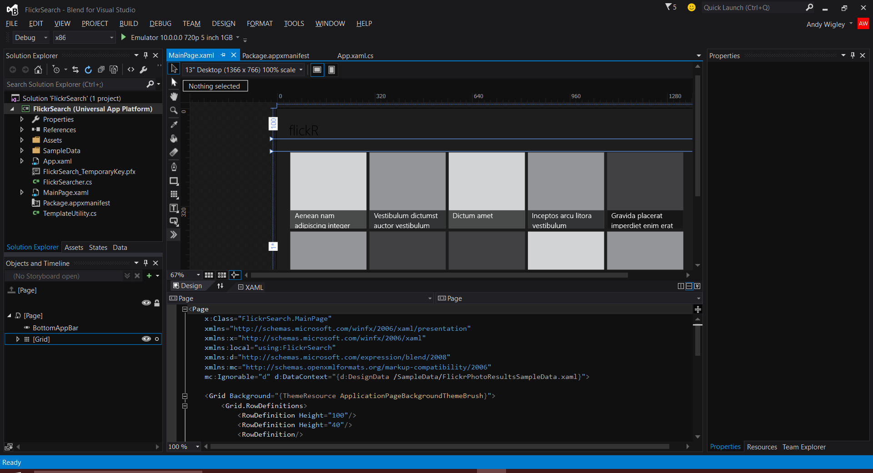
Blend, the XAML developer’s IDE
Visual Studio Shell
XAML Intellisense
XAML Peek
Sync Settings
Quick launch
Classic Blend
Resources
Data
Storyboards
States
Behaviors

Slide 9

Controls in the XAML toolbox

Slide 10
Design considerations
Keep your design fluid
Responsive design
Minor screen sizes
Adaptive design
Major screen changes
Tailored design
Device-specific layouts

Slide 11
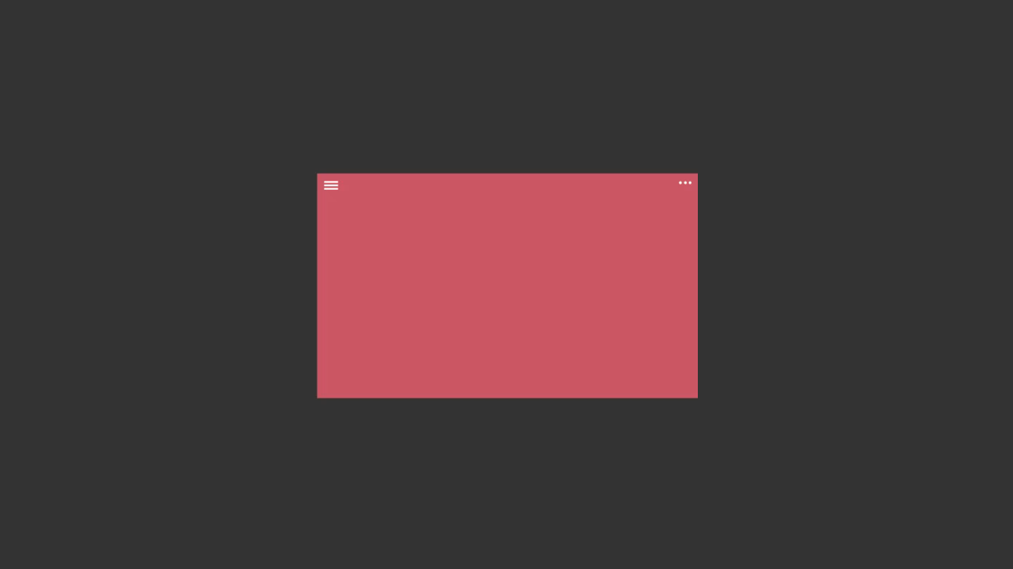
Layout controls
<Border Thickness="" Brush="" />
<Canvas />
<Grid />
<RelativePanel />
<ScrollViewer />
<SplitView DisplayMode="" />
<StackPanel Orientation="" />
<VariableSizedWrapGrid />
<ViewBox Stretch="" />

Slide 12
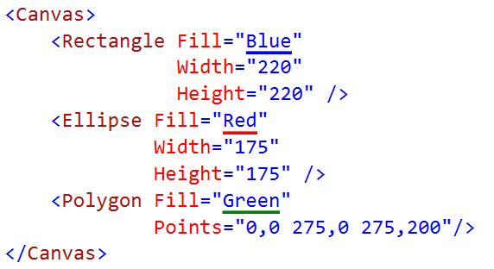

Canvas

Slide 13
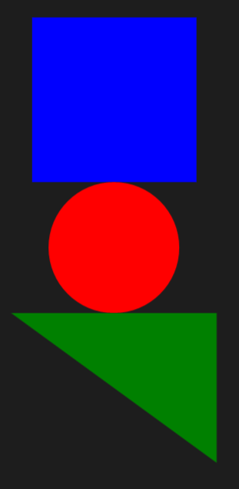
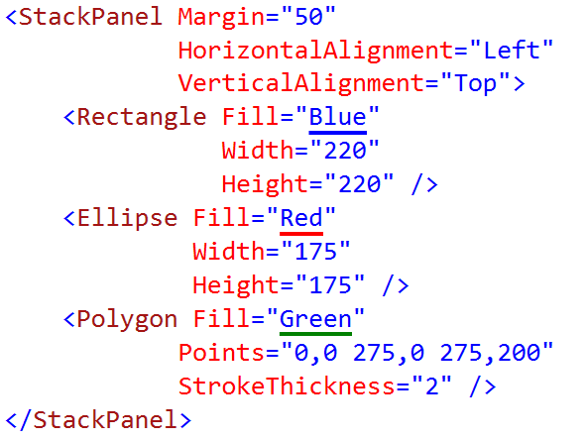
StackPanel

Slide 14
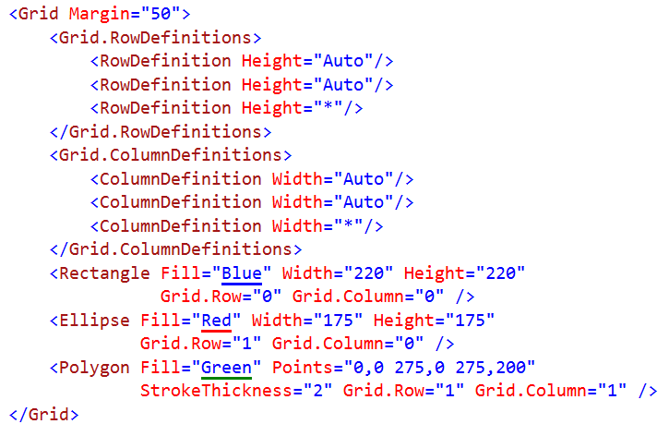
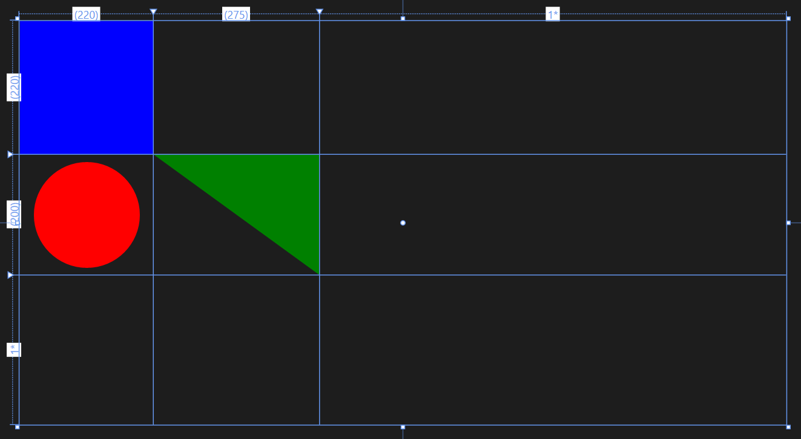
Grid

Slide 15
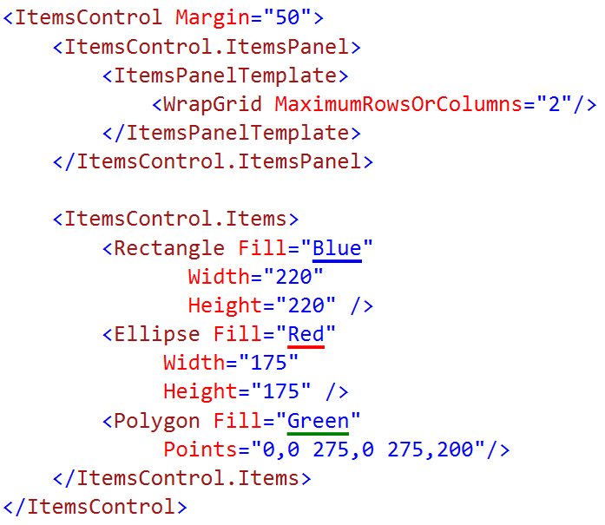
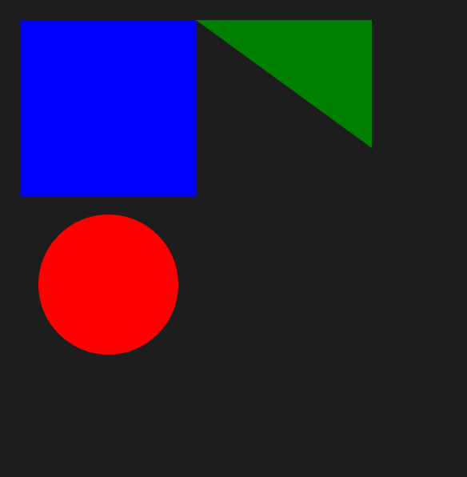
WrapGrid

Slide 16
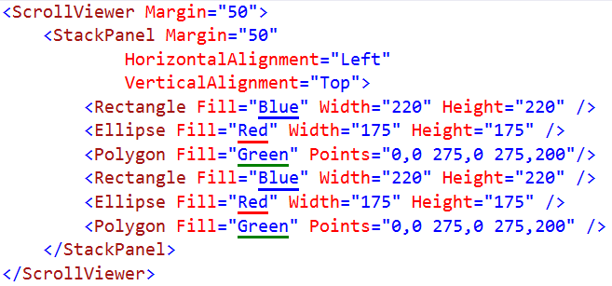
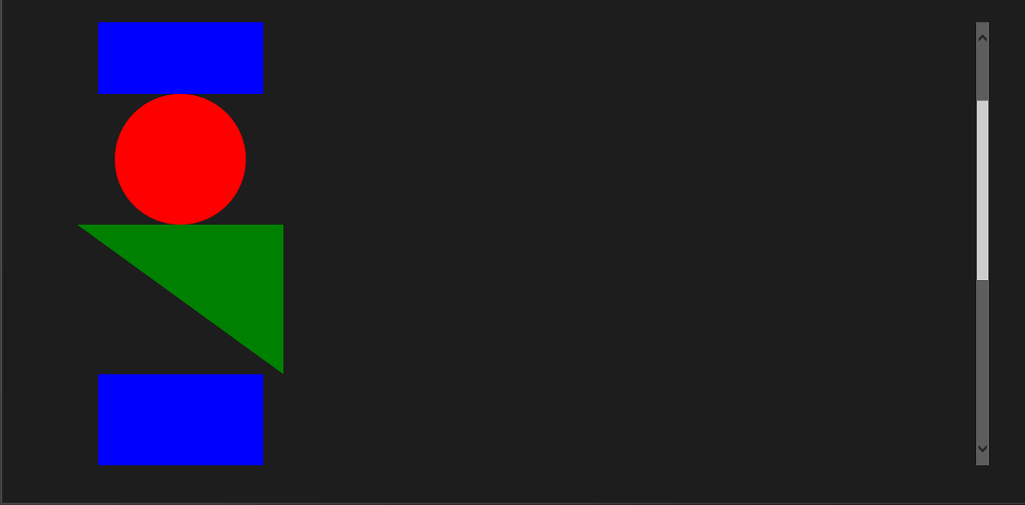
ScrollViewer

Slide 17
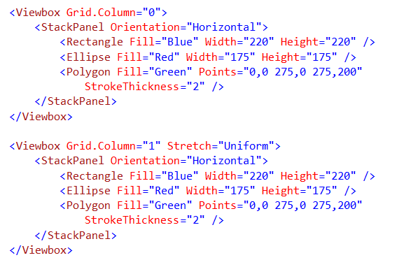
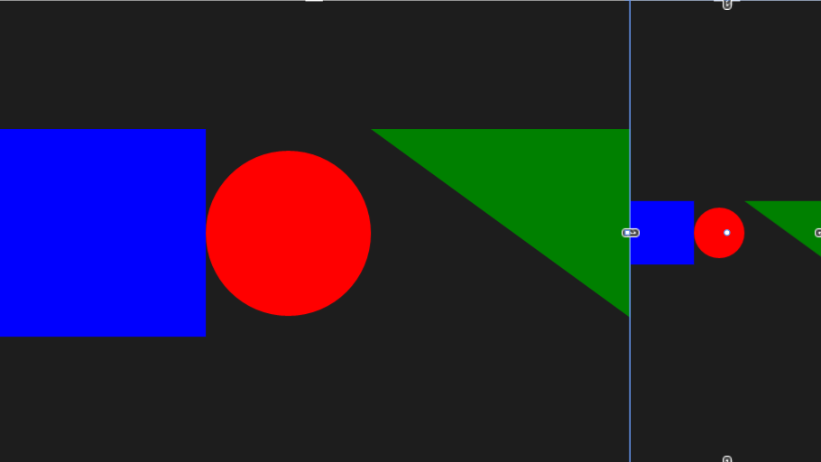
Viewbox

Slide 18

RelativePanel
Some child elements act as anchors
Most child elements relate to others
It's a layout technique friendly with States

Slide 19
SplitView
 | IsPaneOpen="True" | IsPaneOpen="False"
DisplayMode= "Inline"
DisplayMode= "Overlay"
DisplayMode= "CompactInline"
DisplayMode= "CompactOverlay"

Slide 20
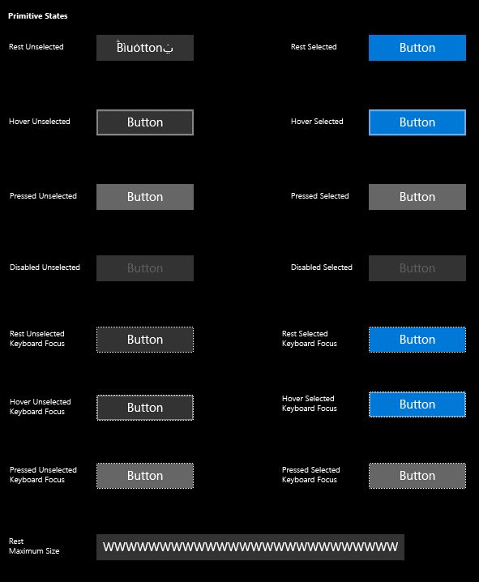
Buttons
<Button Content="" />
<HyperlinkButton />
<RepeatButton />
<ToggleButton IsChecked="" />

Slide 21
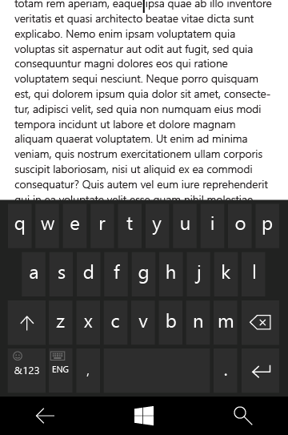
Text controls
<TextBox Text="" />
<PasswordBox Text="" />
<TextBlock Text="" />
<RichEditBox Content="" />
<RichTextBlock Content="" />
<BitmapIcon UriSource="" />
<FontIcon Glyph="" />
<SymbolIcon Icon="" />
<PathIcon Data="" />

Slide 22
Text controls

Slide 23
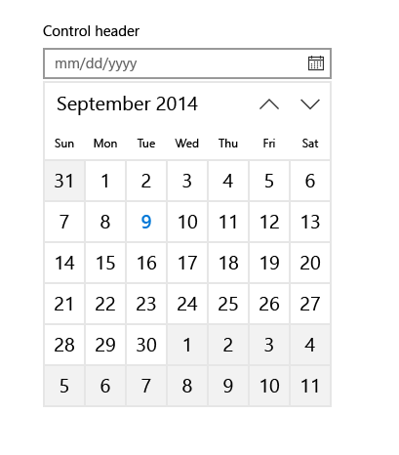
Selection and picker controls
<CalendarView />
<DatePicker Date="" />
<TimePicker Time="" />
<ToggleSwitch IsChecked="" />
<CheckBox IsCHecked="" />
<RadioButton IsChecked="" />
<ComboBox />
<ListBox />
<Slider Minimum="" Maximum="" />

Slide 24
Selection & pickers

Slide 25
Collection/data controls
<DataTemplate />
<ItemsPanelTemplate />
<ControlTemplate />
<ContentPresenter />
<ItemsPresenter />
<ContentControl />
<ItemsControl ItemsSource="" />
<FlipView />
<GridView />
<ListView />
<SematicZoom />
<Hub Orientation="" />
<ContentControl ControlTemplate="" />

Slide 26
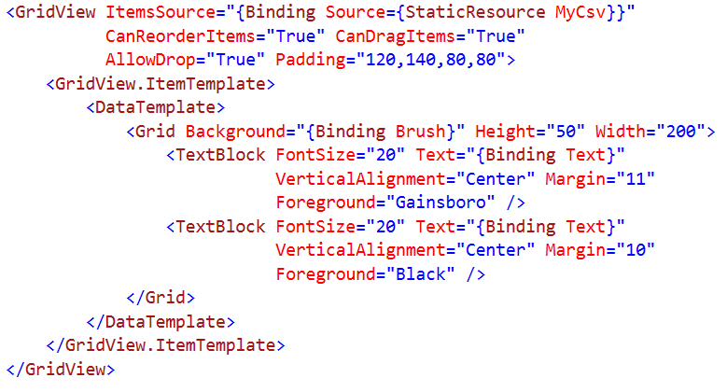
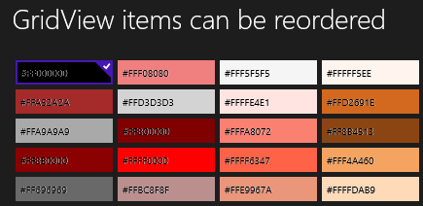
Grid View Syntax

Slide 27
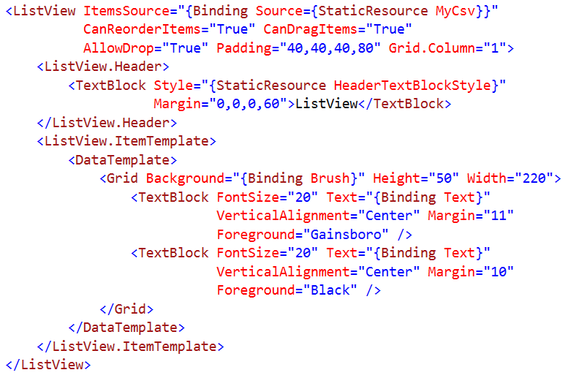
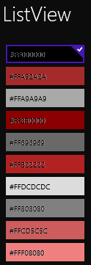
List View Syntax

Slide 28
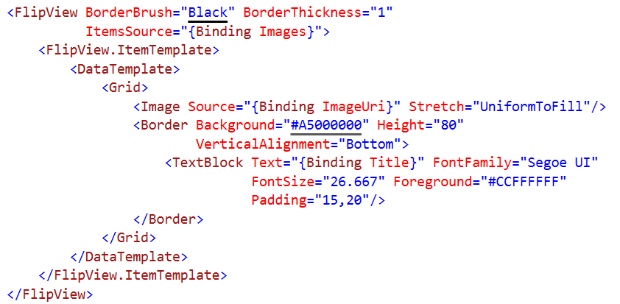

Flip View Syntax

Slide 29
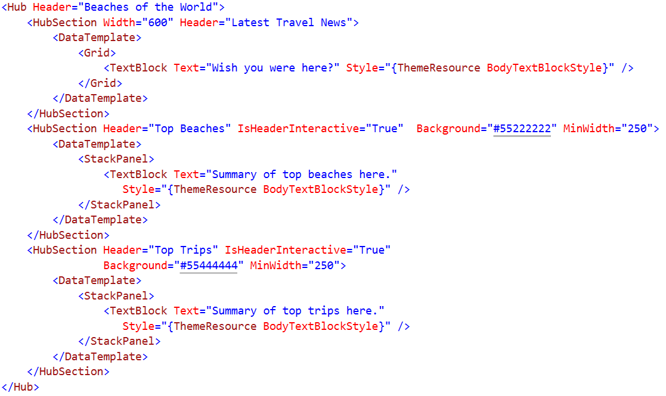

Hub Syntax

Slide 30
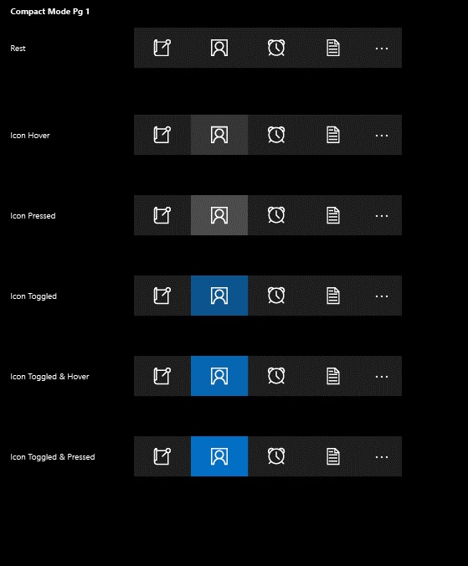
App bars and commands
<AppBar />
<CommandBar />
<AppBarButton Label="" Icon="" />
<AppBarToggleButton IsChecked="" />
<AppBarSeparator />

Slide 31
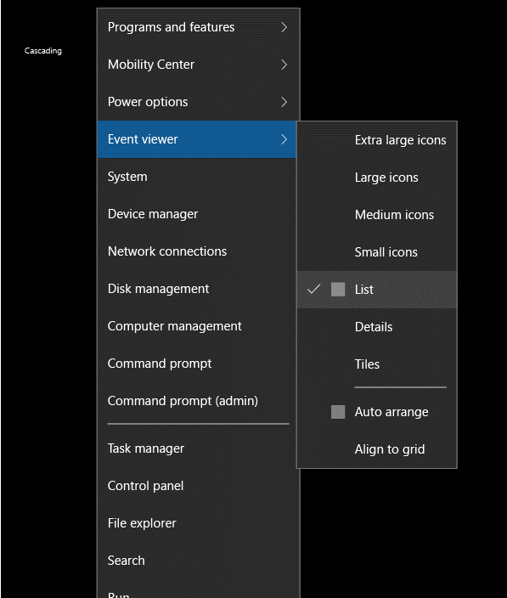
Flyout controls
<Popup IsOpen="" />
<ContentDialog Title="" Content="" />
<Flyout Placement="" />
<MenuFlyout />
<ToolTip />

Slide 32
Flyout controls

Slide 33
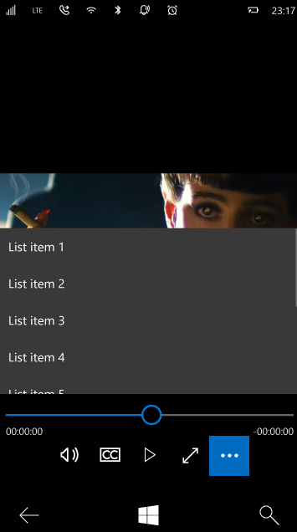
Progress, Media & Inking controls
<ProgressBar IsIntermediate="" />
<ProgressRing IsActive="" />
<Image />
<InkCanvas />
<MediaElement />
<CaptureElement />

Slide 34
Media and inking

Slide 35
What is a XAML resource?
System resources
ThemeResources
Custom resources
Values (like font size)
Objects (like color brushes)
Control styles
BasedOn
Templates
Control templates
Data templates

Slide 36
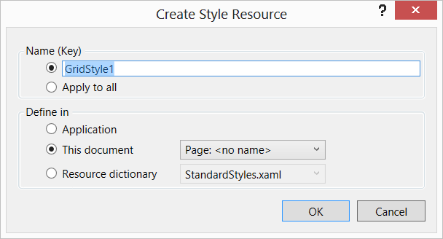
Resource Scope

Slide 37

Screenshot walkthoughs

Slide 38
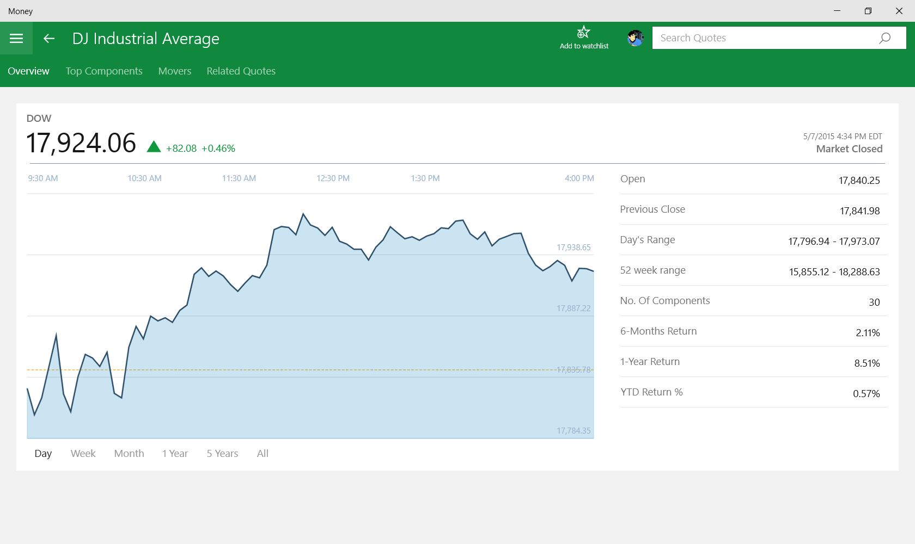

Slide 39
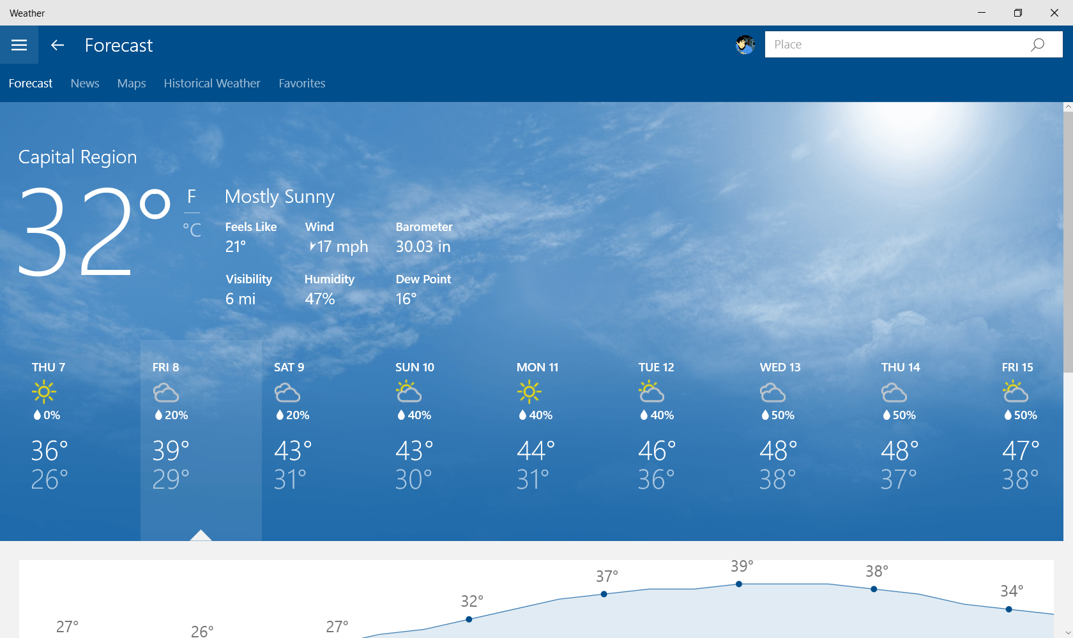

Slide 40
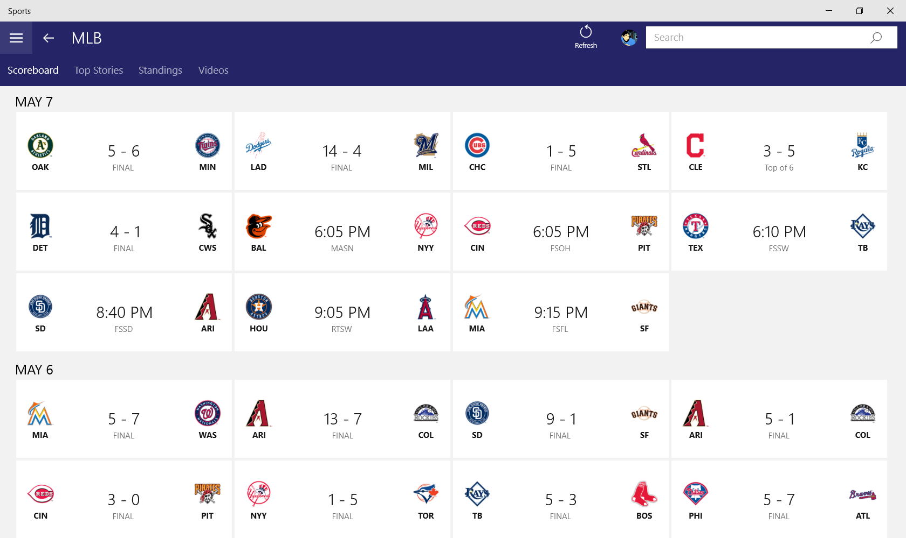

Slide 41
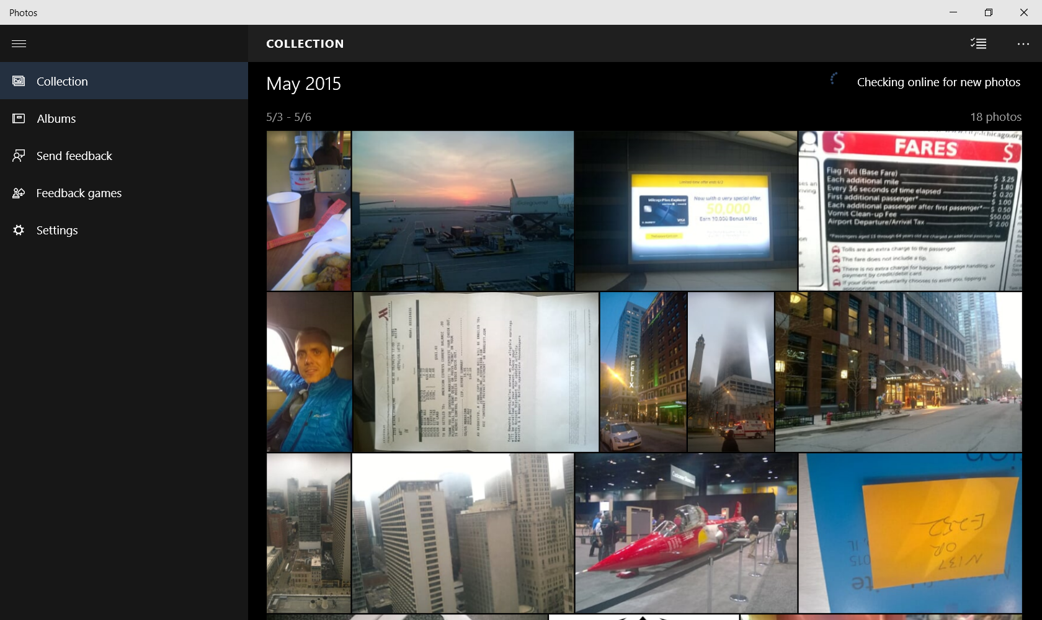

Slide 42
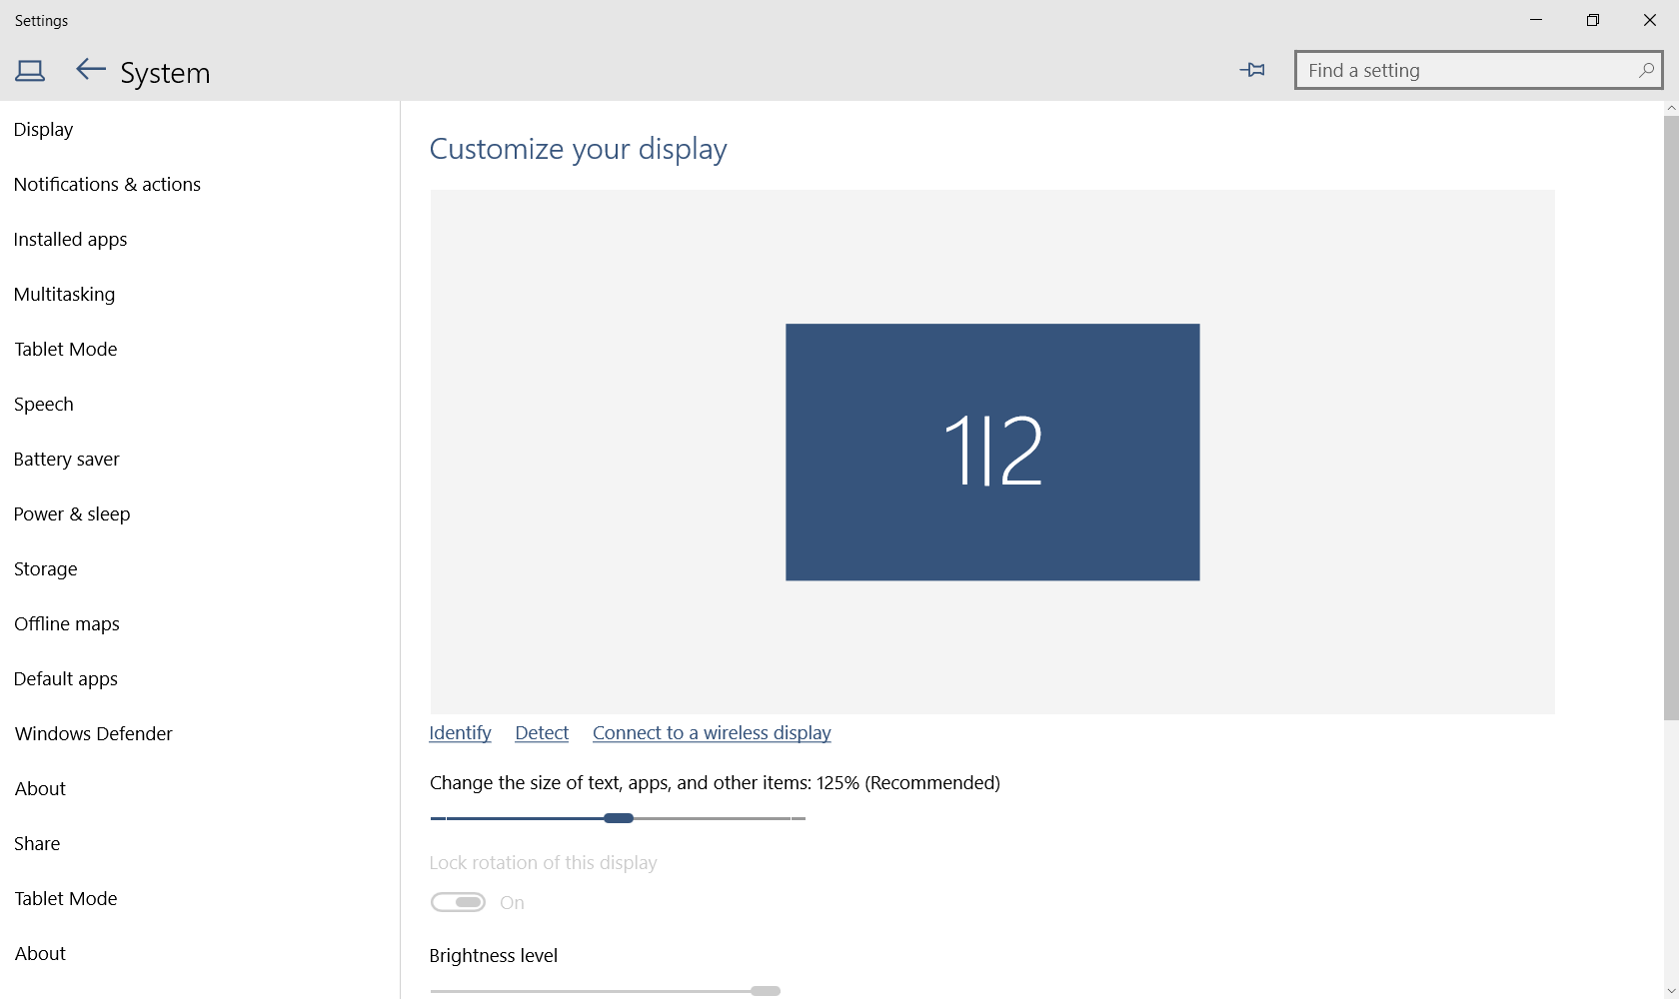

Slide 43
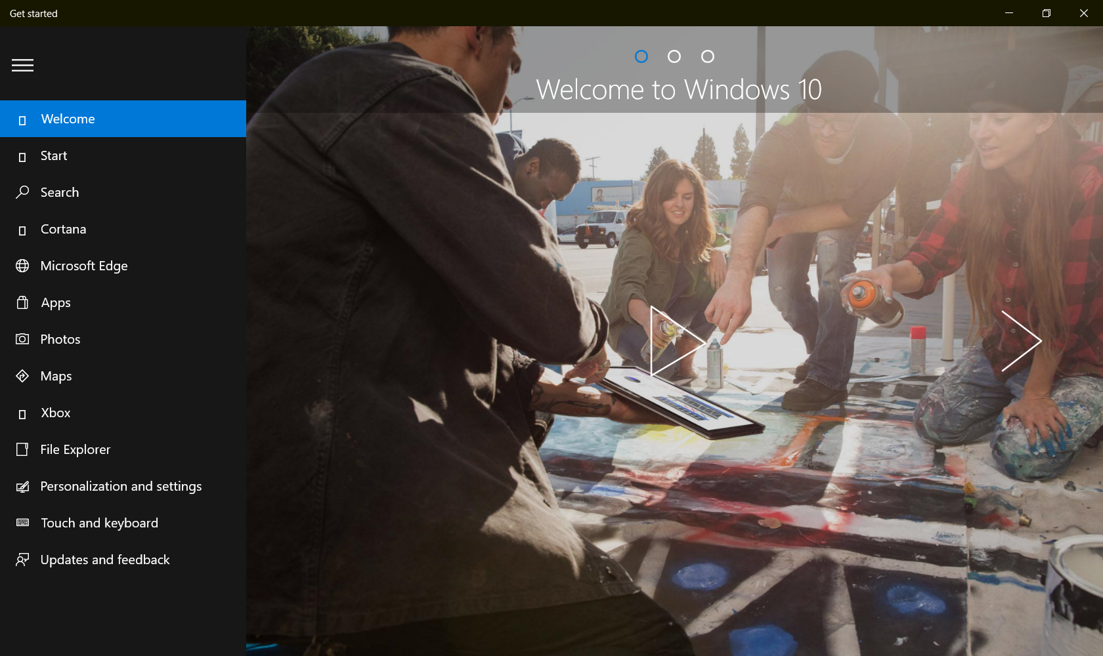

Slide 44
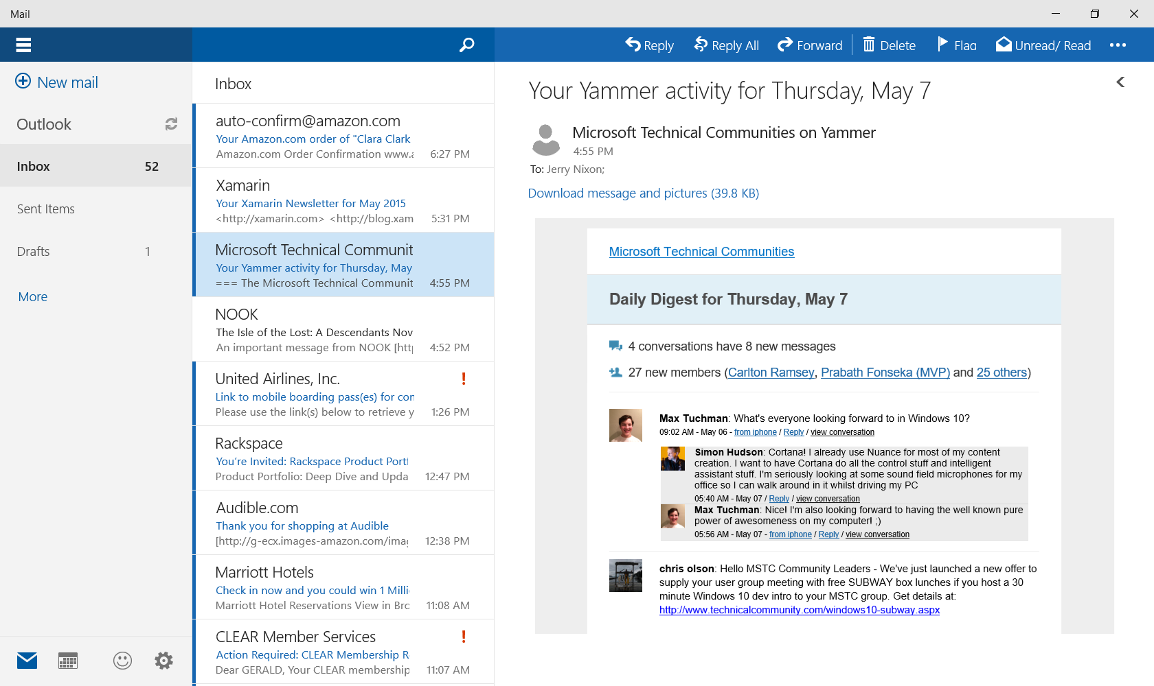

Slide 45
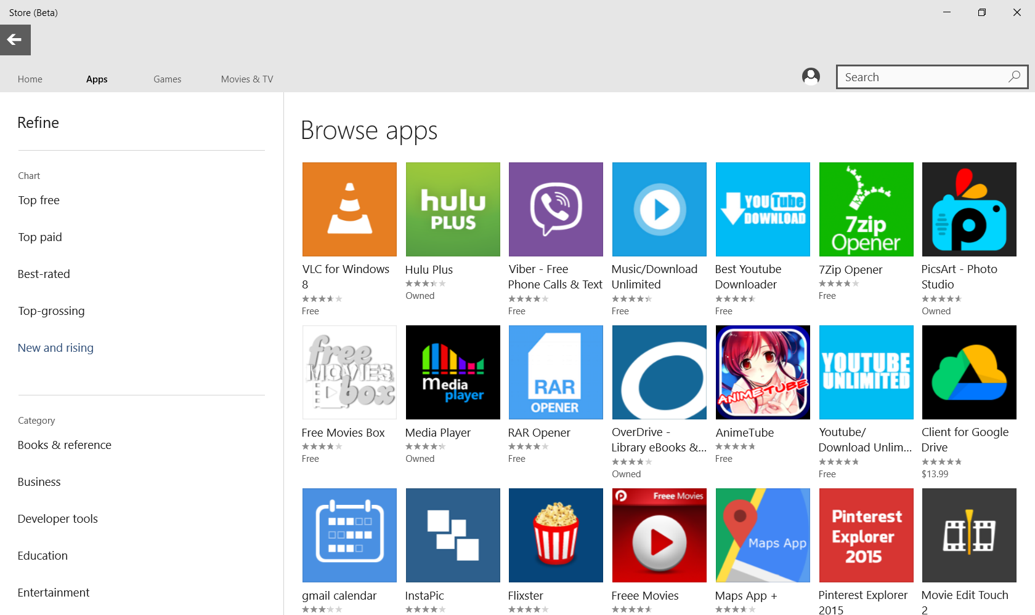

Slide 46
Using standard controls gets you a long way

Slide 47
The emerging XAML story
Controls in the XAML toolbox
Screenshot walkthroughs

